Slide 1
Heart Attack Analysis and Prediction

Slide 2
INTRODUCTION
Cardiovascular diseases, including heart attacks, are a leading cause of mortality globally.
Early prediction and accurate analysis can play a crucial role in improving patient outcomes.
This project utilizes machine learning techniques to predict the likelihood of a heart attack and provides meaningful insights from the data.

Slide 3
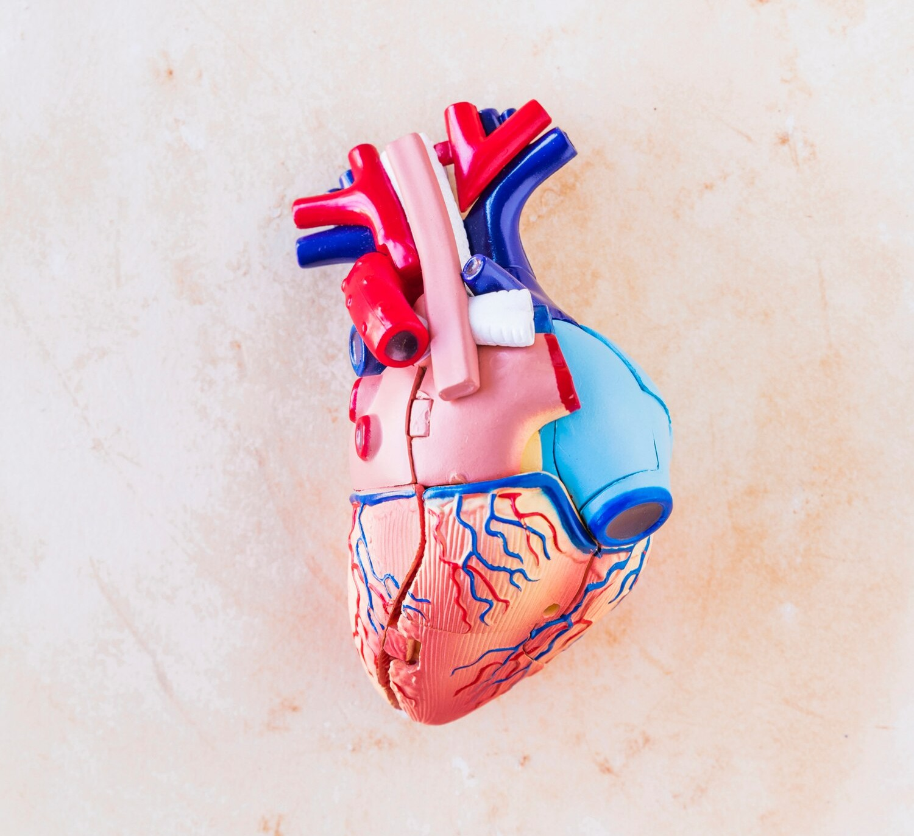

UNDERSTANDING HEART ATTACKS
Deﬁning the and risk factors of heart attacks. Exploring the
importance of early
and in preventing
accurate
cardiac catastrophes.

Slide 4
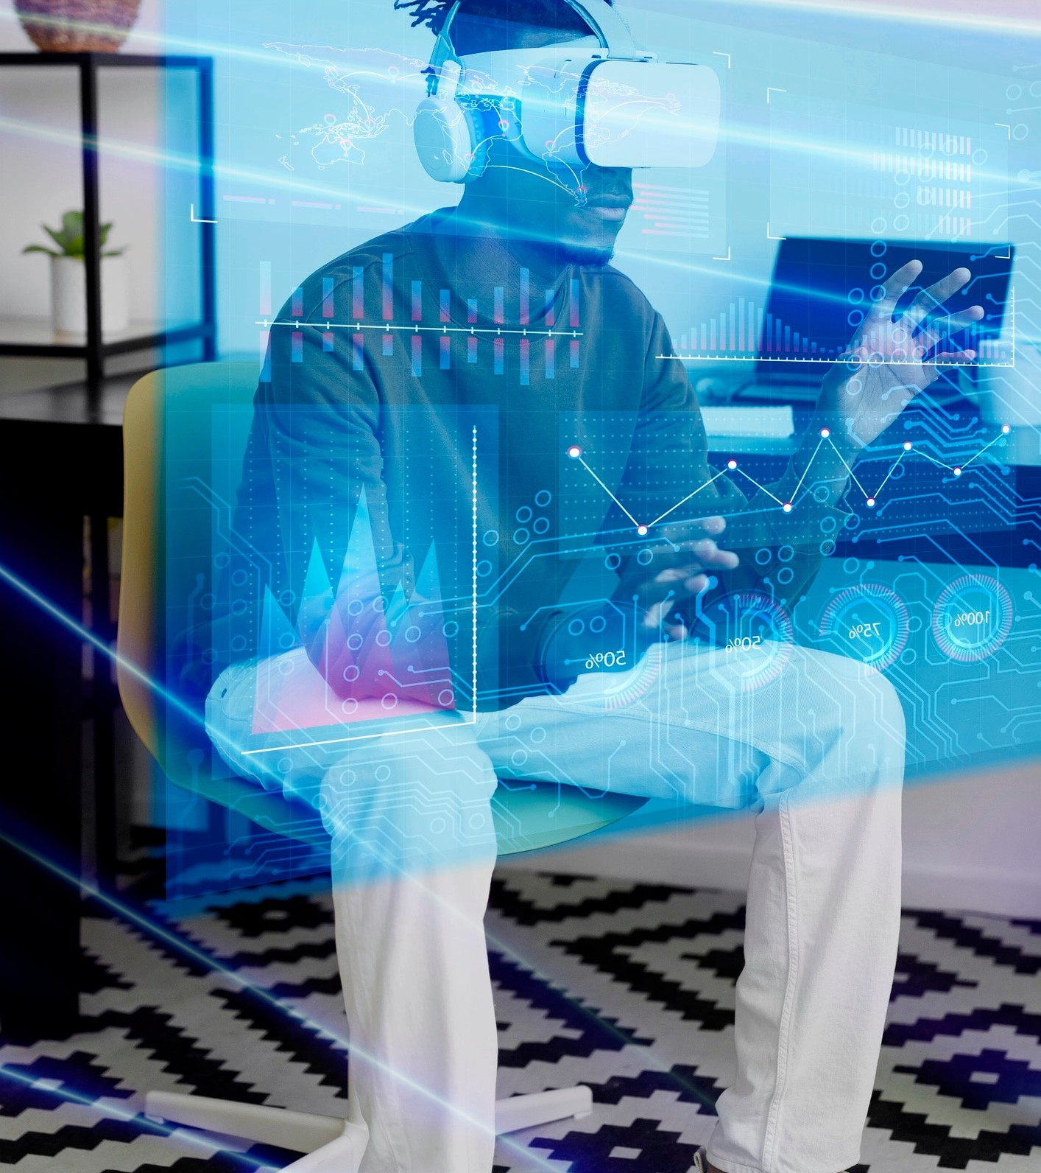
Features
Data preprocessing and exploration
Feature selection and engineering
Machine learning model development
Prediction of heart attack risk
Data visualization for analysis

Slide 5
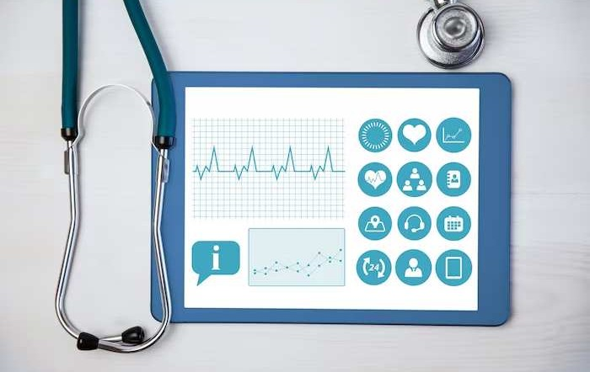
DATA COLLECTION AND PREPROCESSING
Exploring the challenges and strategies in acquiring and preparing cardiac data
for machine learning analysis.
Emphasizing the importance of clean, diverse, and representative datasets.
.
The dataset used for this project is sourced from Kaggle. It contains various attributes such as age, sex, blood pressure, cholesterol levels, etc. that are relevant to heart health.

Slide 6

FEATURE ENGINEERING AND SELECTION
Understanding the process of
and its impact on model performance. Highlighting the signiﬁcance of
in cardiac data analysis.

Slide 7
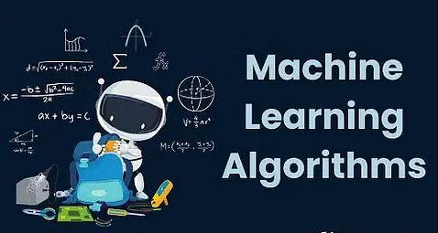
Machine Learning Algorithm
Used multiple machine-learning techniques such as Logistic Regression, KNN, SVM, Decision Tree and Random Forest to predict the risk of a heart attack. The model is trained on a labeled dataset and evaluated using relevant metrics.

Slide 8
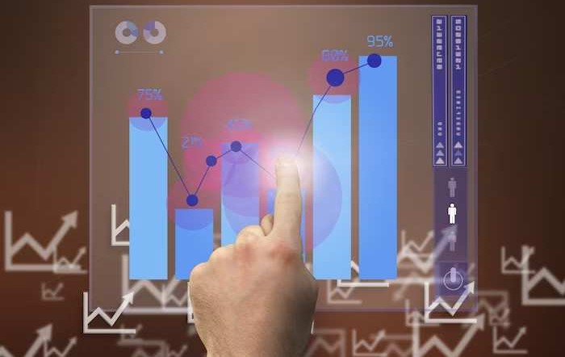

MODEL TRAINING AND VALIDATION
Exploring the and
of
machine learning models for heart attack prediction. Discussing the
importance of
and
in evaluating model accuracy.

Slide 9
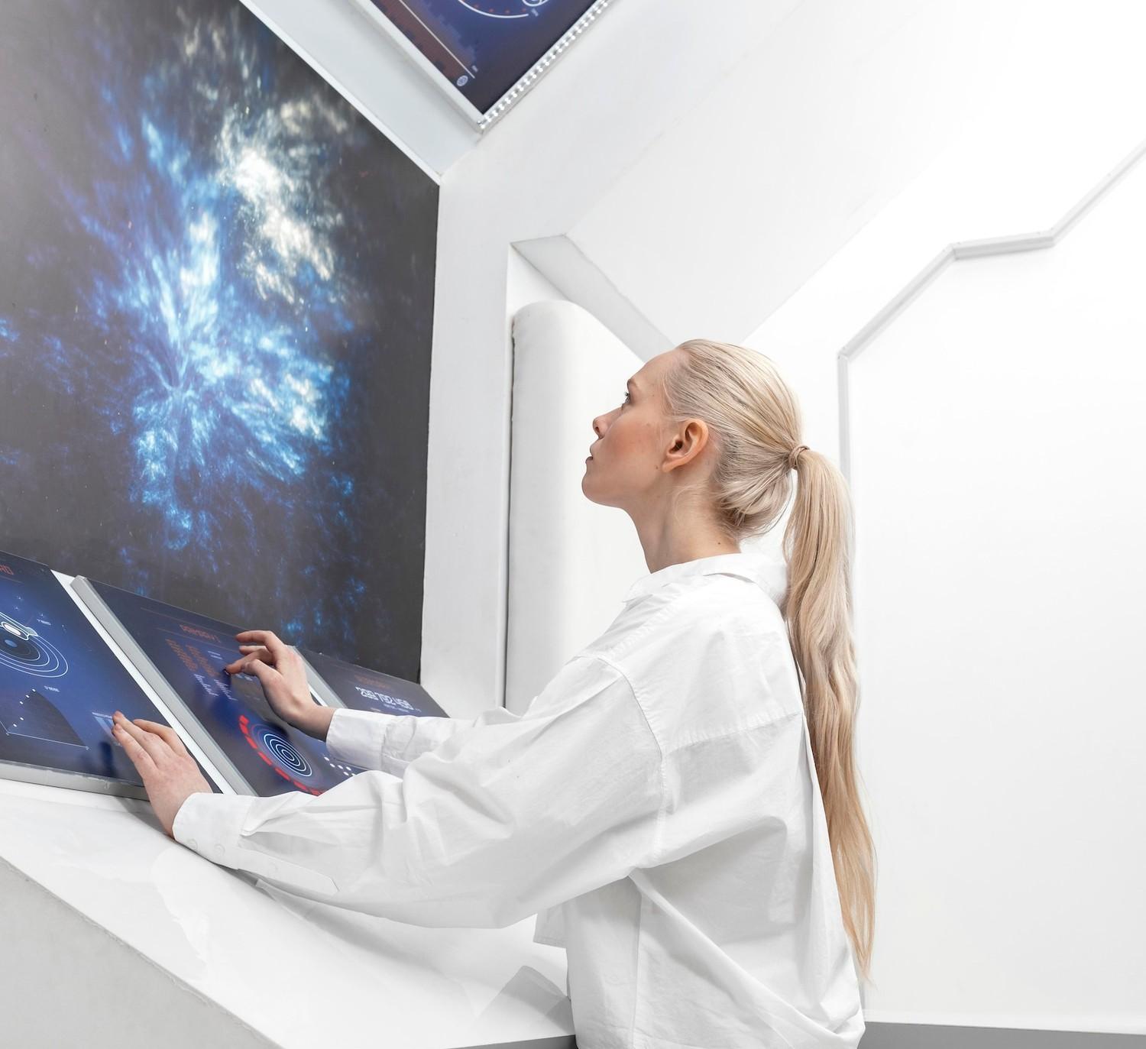

REAL-WORLD APPLICATIONS
Examining the
and of advanced
machine learning approaches in cardiac catastrophe analysis. Showcasing success stories and ongoing research in the ﬁeld.

Slide 10
CONCLUSION
Compared the results obtained from all five techniques and SVM performed the best among the five

Slide 11
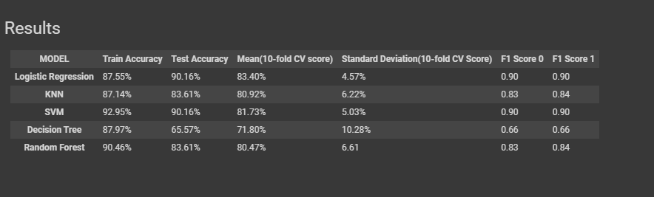

Slide 12
Thanks!

